Slide 1

Learning about evolution by building coalescent trees
2021 EMBO Course in Population Genomics
Leo Speidel

Slide 2

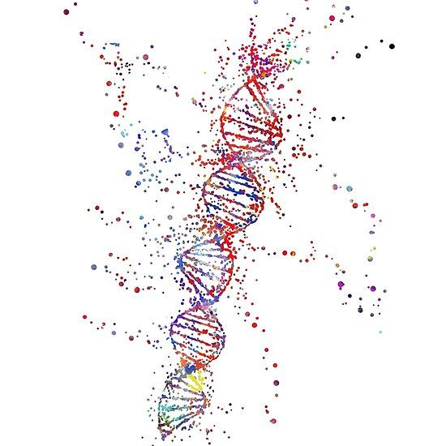

How are we all related?
Everyone is different
Yet people share lots of characteristics (hair colour, blood group, disease susceptibility)
Relatives tend to be more similar
How does genetic variation arise and how is it maintained?
Big family tree?

Slide 3
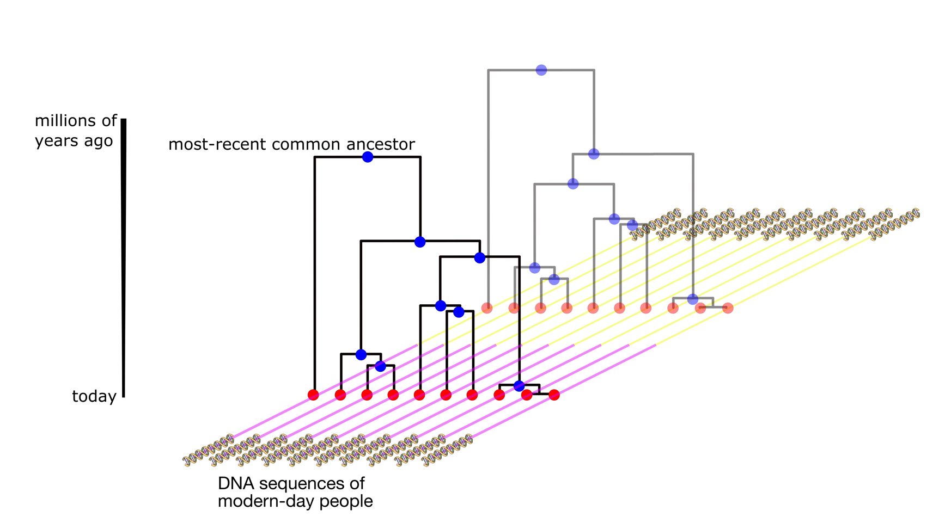
Key concept: Genealogies We are genetically related through a sequence of trees
genome
Reason for why trees change along the genome
Recombination:
Mother
Father
Inherited from grandfather
Inherited from grandmother
child

Slide 4
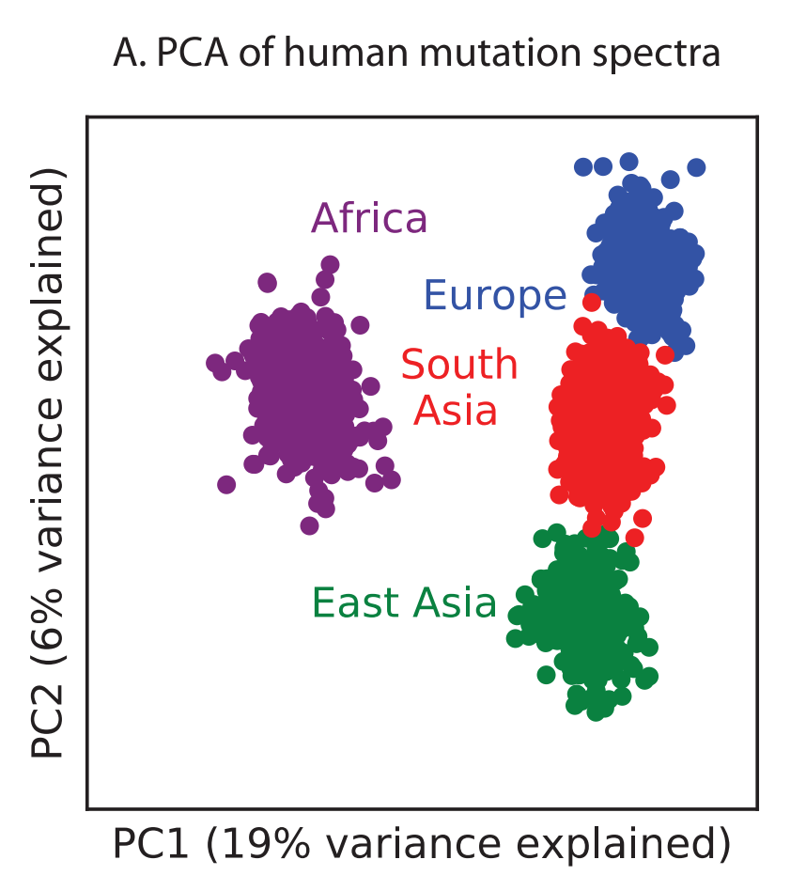
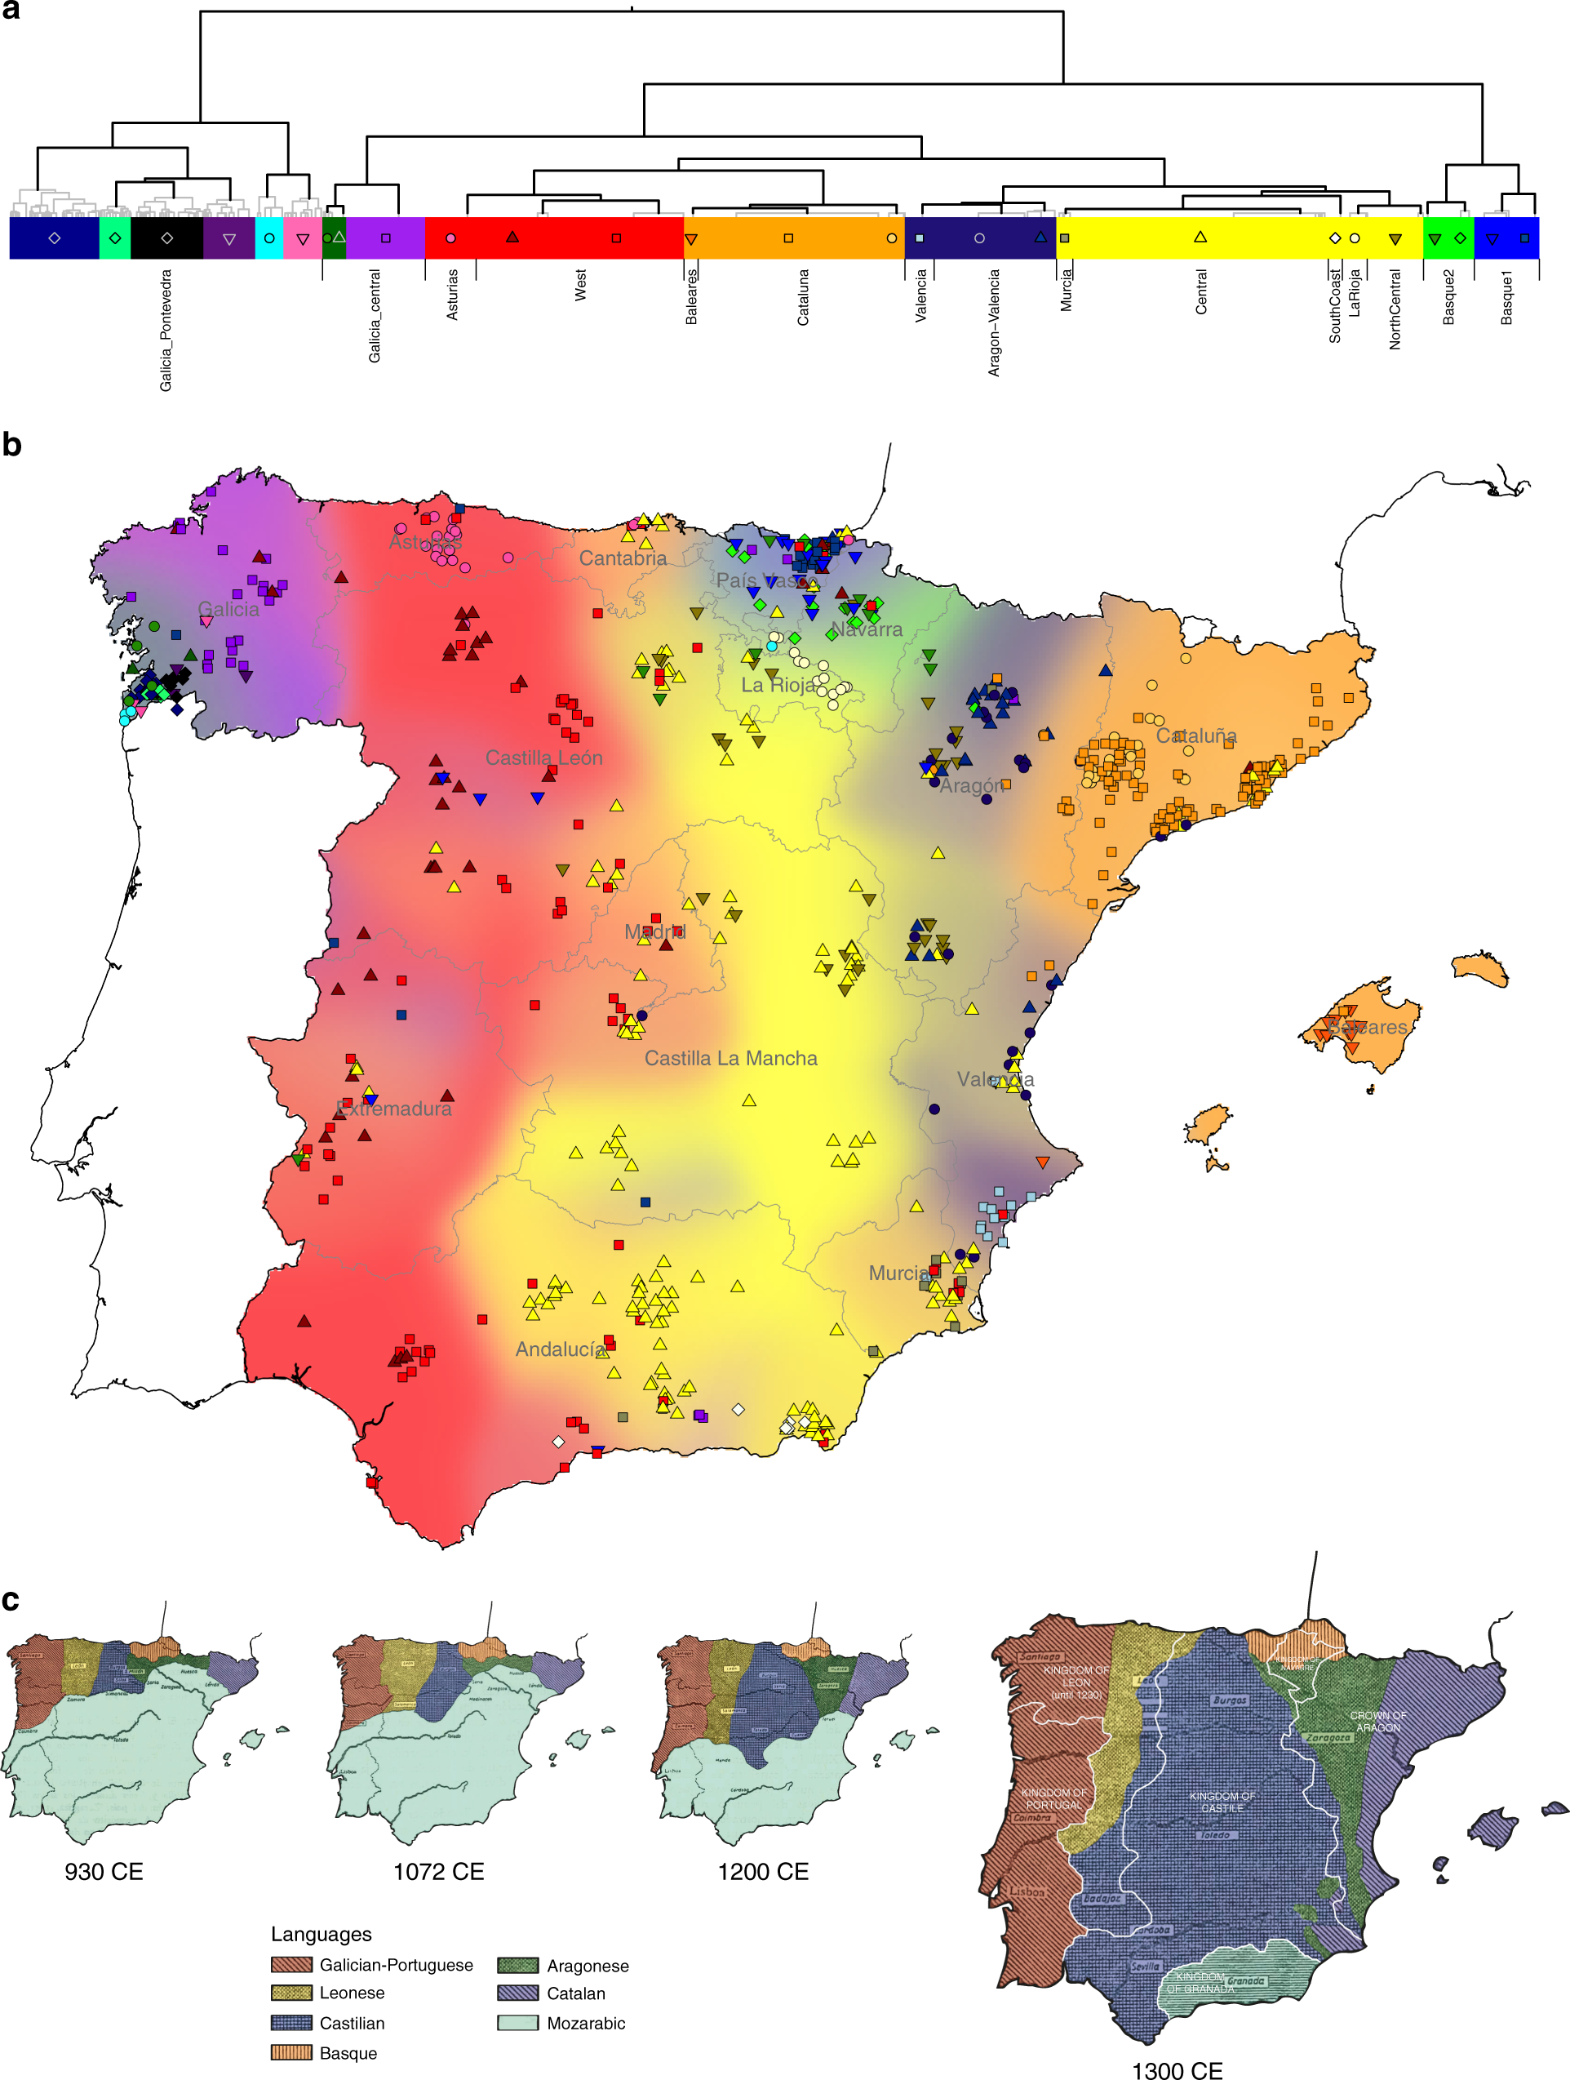
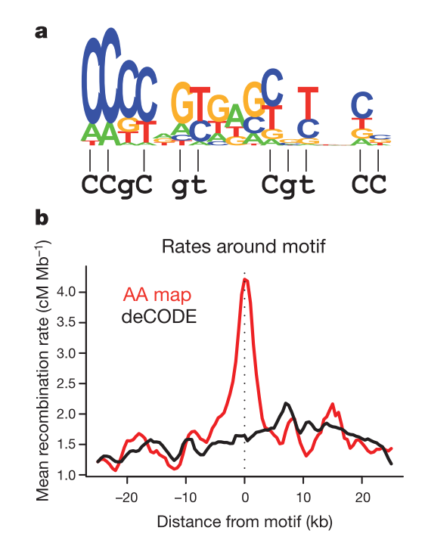
Processes impacting tree shapes and genetic diversity
Harris et al, eLife 2017
Bycroft et al, Nat Commun 2019
Genetic variation is shaped by
Structure and migrations
Population bottlenecks
Admixture
Mutation
Recombination
Selection
Etc
Hinch et al, Nature 2011
These evolve over time!
“evolution of evolution”

Slide 5
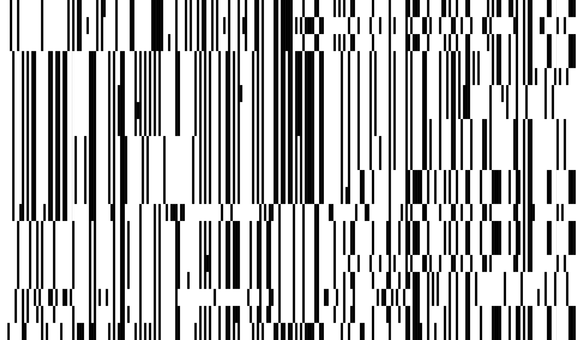
Fundamental forces impact data (only) through underlying genealogies
polymorphic sites
individuals
Demographic history
Genetic structure
Mutation, recombination, etc.

Slide 6
Many canonical approaches
polymorphic sites
individuals
Demographic history
Genetic structure
Mutation, recombination, etc.
Invent informative statistics, simplify, "integrate out all possible histories"

Slide 7
Genealogies are the “unobserved link” between evolutionary processes and genetic variation
polymorphic sites
individuals
Demographic history
Genetic structure
Mutation, recombination, etc.
Inferred trees reorganise all the information available from the data about these processes in a very accessible & powerful way
Challenges: computationally very challenging to sample trees from the data, and modern datasets can contain >50,000 individuals and >100,000,000 mutations

Slide 8
Inferring genealogies
Old problem, lots of methods, but few can scale:
ARGweaver
Rent+
Tsinfer + tsdate
Relate
We will talk about Relate, but principles of
tree-based inference applies more generally!
Infers Ancestral Recombination Graphs
Published in 2019/2021,
scale to large sample sizes

Slide 9
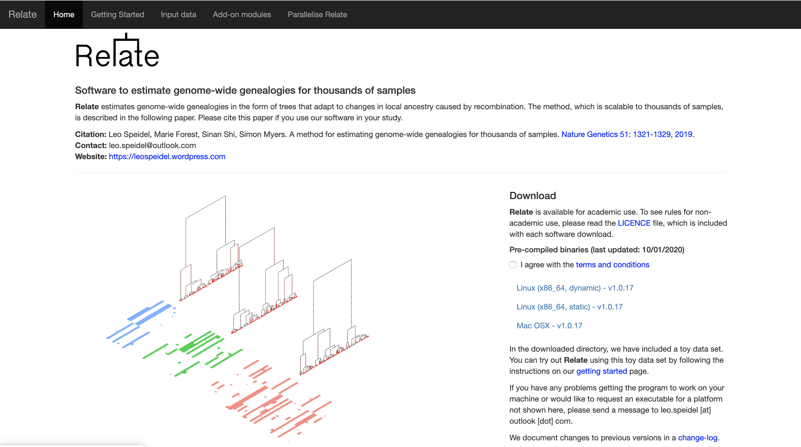
Relate
L. Speidel, M. Forest, S. Shi, S. Myers. Nature Genetics 2019
https://myersgroup.github.io/relate/
Key features:
Fast & accurate
Robust to errors!
Jointly infers branch lengths and demographic history
Moderns and ancients
Lots of add-on tools for various types of analyses

Slide 10
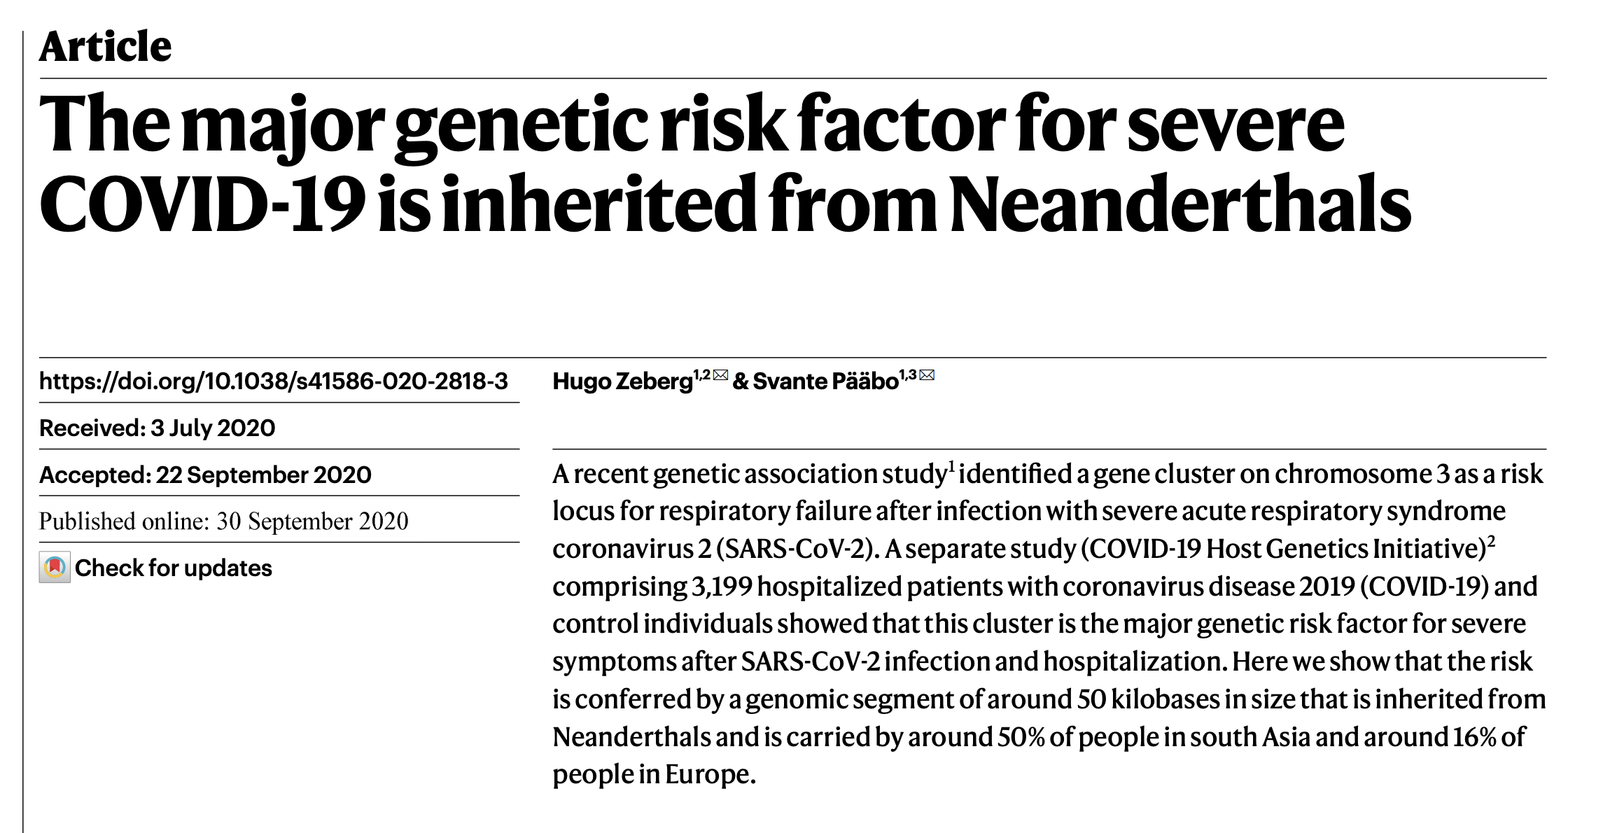
One locus can already tell us a lot about our history
Neanderthal
Denisova
~60k years ago
Notes:
Swap tree plot

Slide 11
Positive selection: rapidly spreading lineage
Lactose tolerance
as adults (rs4988235)

Slide 12
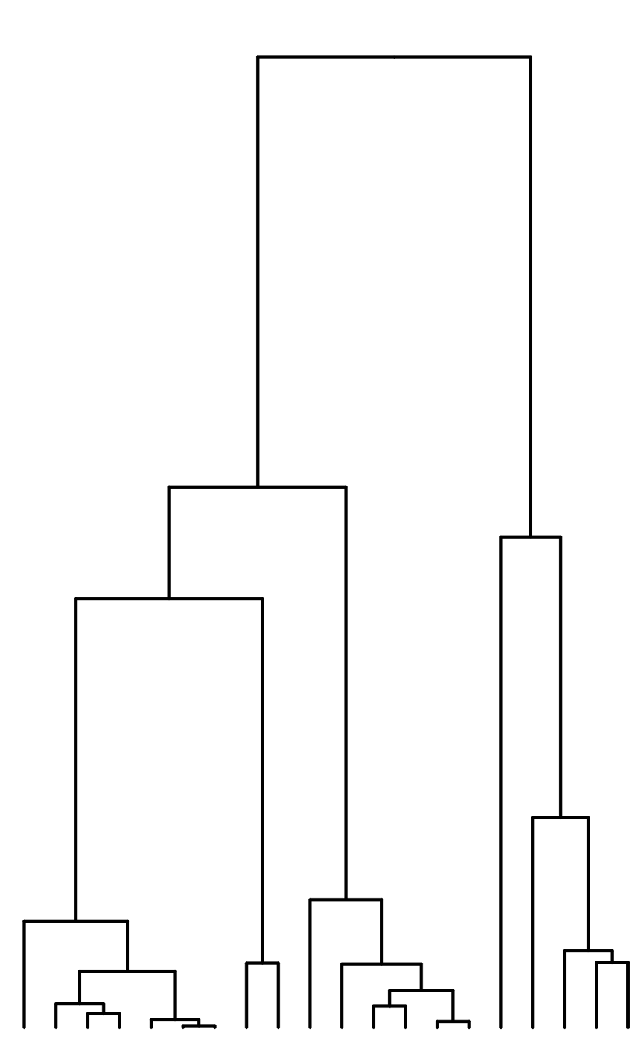
Clusters of mutations in time can capture changes in mutation rate
Mutation rate
time

Slide 13
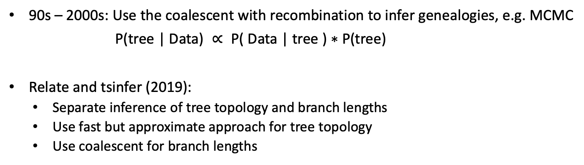
Inferring genealogies
Old problem
90s – 2000s: Use the coalescent with recombination to infer genealogies, e.g. MCMC
$\text{P}\text{(}\text{tree}\text{ | }\text{Data}\text{) }∝ \text{P}\text{( }\text{Data}\text{ | }\text{tree}\text{ ) ∗ }\text{P}\text{(}\text{tree}\text{)}$
Relate and tsinfer (2019):
Separate inference of tree topology and branch lengths
Use fast but approximate approach for tree topology
Use coalescent for branch lengths
coalescent
Scalable to many
thousands of samples

Slide 14
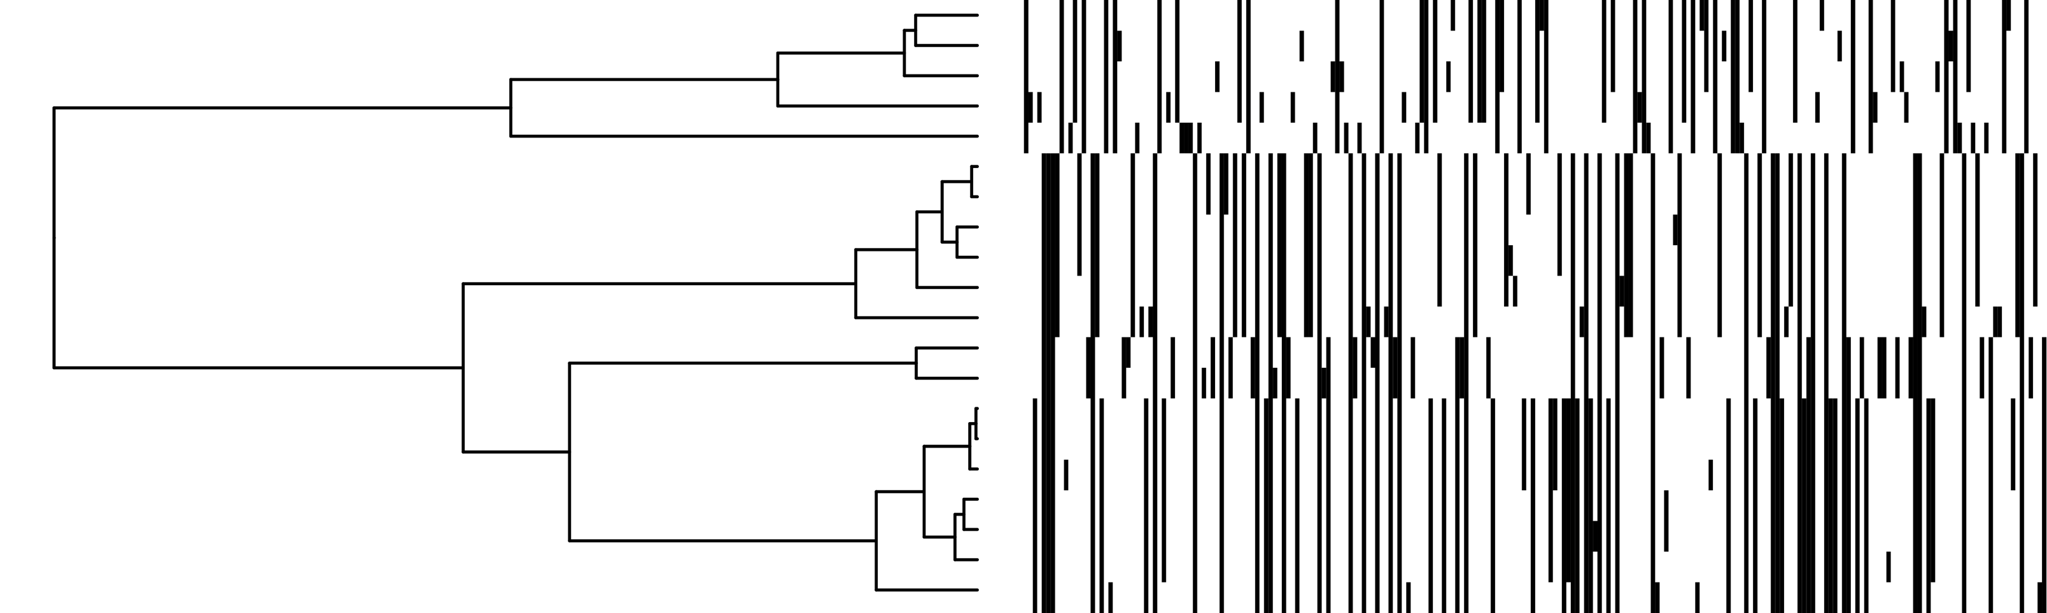
Data and the underlying tree structure
Every mutation shows the existence of a branch
Mutations are “ordered by inclusion”
No two branches (mutations) ever show only partial overlap

Slide 15
Use hidden Markov model to identify stretches where relationships to other are unchanged
For tree topology, we want to quantify the order in which we are related to others
Count number of “derived mutations”
E.g., sequence a has 1 derived mutation to (b,c)
2 derived mutation to (d,e,f)
Coalesce mutually closest lineages
No recombination: Guaranteed to build tree consistent with data
This is not the case if we use “pairwise differences” (UPGMA)
a and (d,e,f) are closer than a and (b,c)
Use HMM to count derived mutations accounting for recombination
a
b
c
d
e
f

Slide 16
Summary of Relate

Slide 17
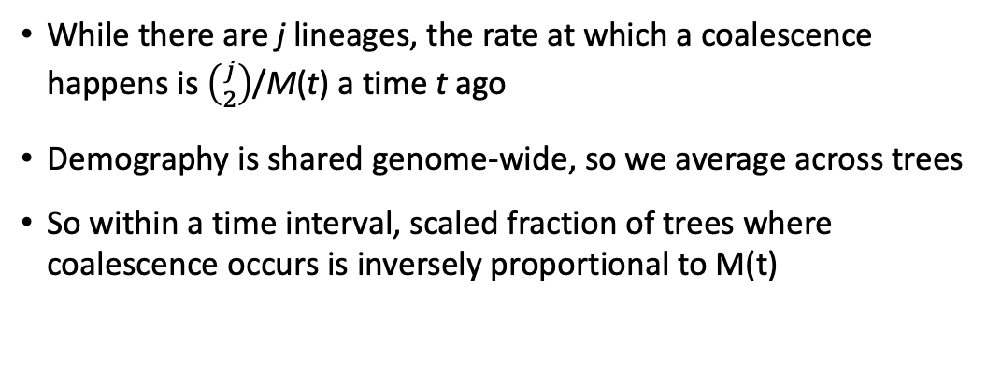
Branch lengths and population size is estimated jointly in an EM algorithm
While there are j lineages, the rate at which a coalescence happens is $\left({j \atop 2}\right)$/M(t) a time t ago
Demography is shared genome-wide, so we average across trees
So within a time interval, scaled fraction of trees where coalescence occurs is inversely proportional to M(t)
Li-and Stephens copying model
Build Relate trees
EM algorithm
Infer branch lengths
using constant M(t)
Infer M(t) from tree
Infer branch lengths
using constant M(t)
Using the coalescent
Using the coalescent
Using the coalescent

Slide 18
Population size changes through time are jointly inferred in Relate
- Effective population size = inverse coalescence rate
- N: number of diploid samples

Slide 19
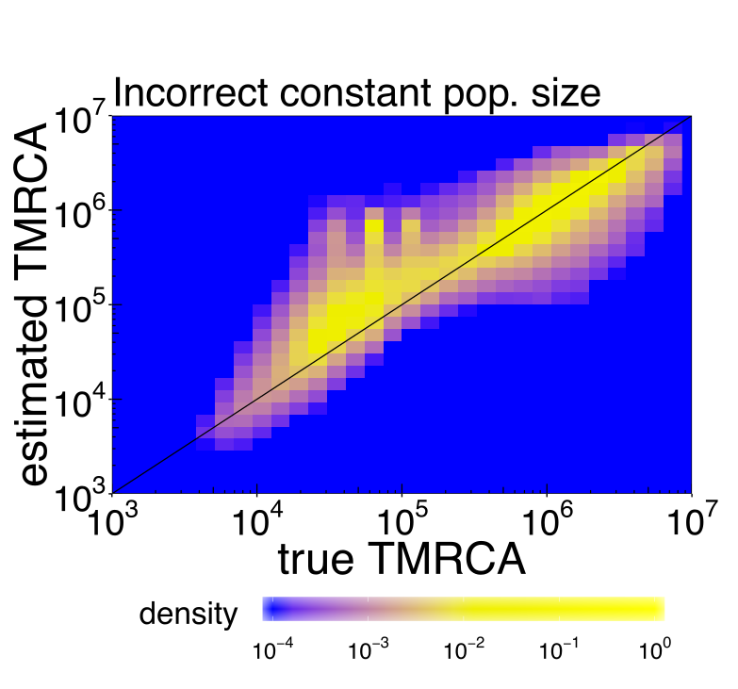
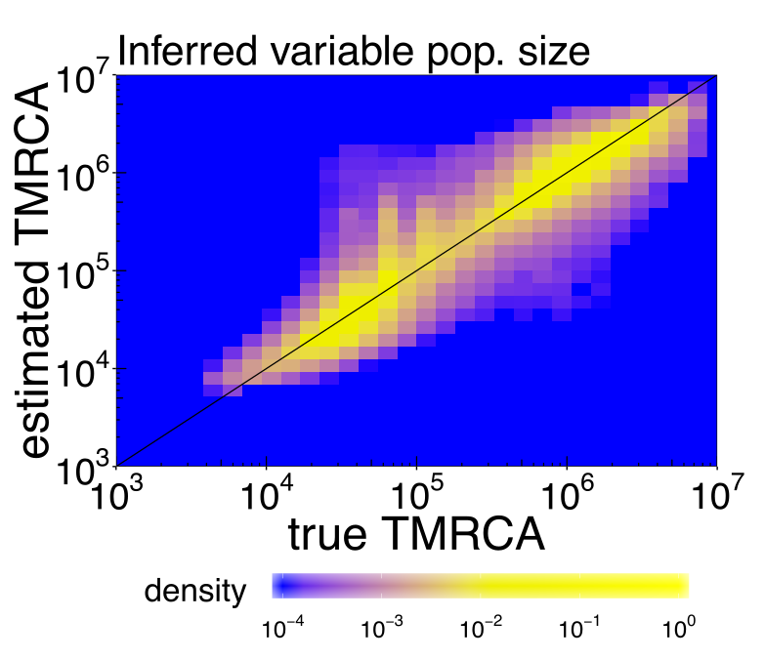
Simulated data with variable population size (European-like demographic history)

Slide 20
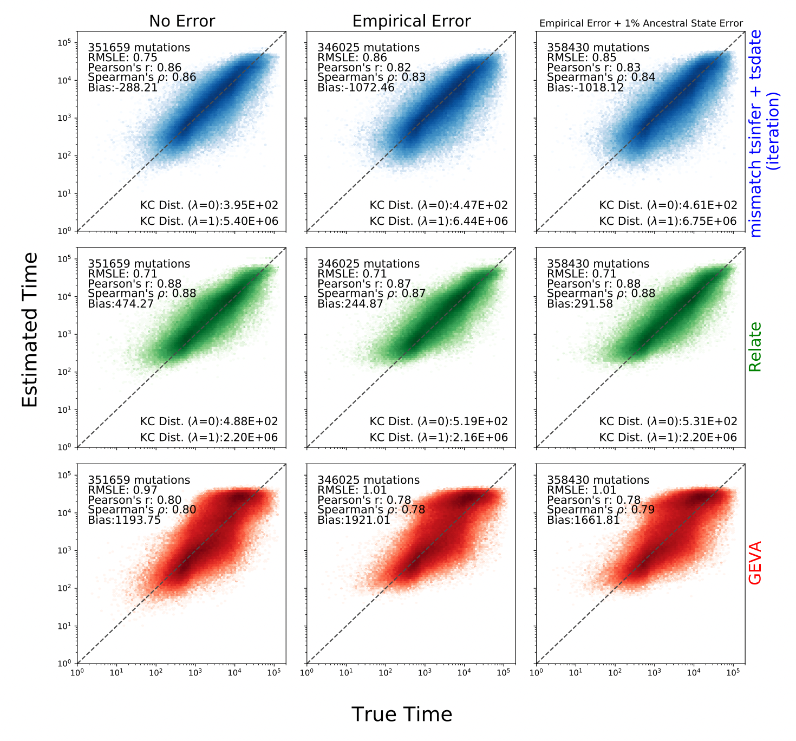
Speed and accuracy of Relate
About 14,000 times faster than previous method, ARGWEAVER (1 min. vs. 200 hours), slower than tsinfer + tsdate
Builds “correct” tree if no recombination
Accurate, robust to data errors
Wohns et al, bioRxiv 2021
Notes:
Use tsdate plots?

Slide 21
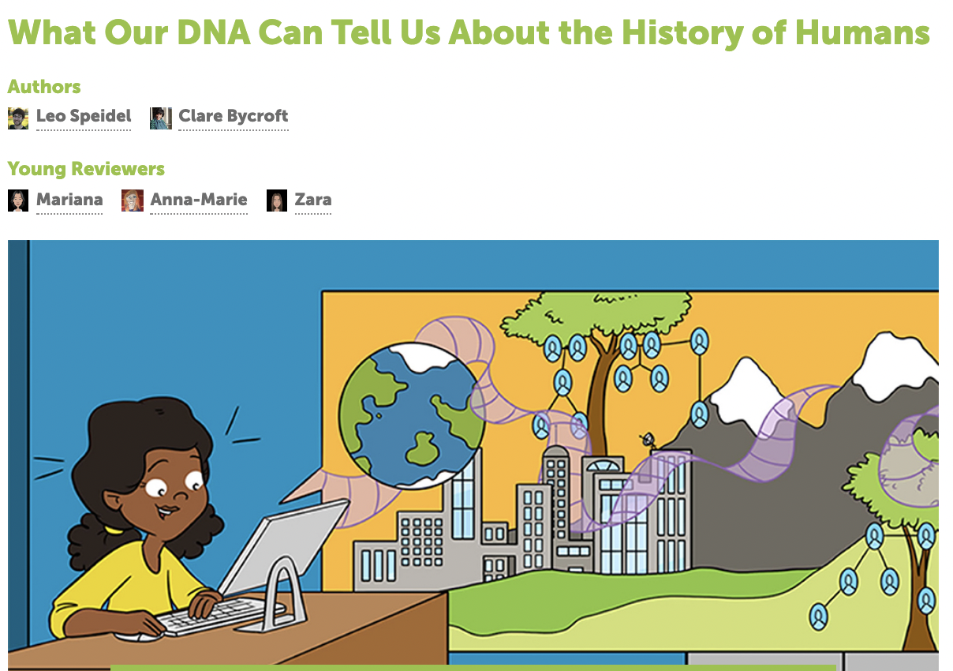

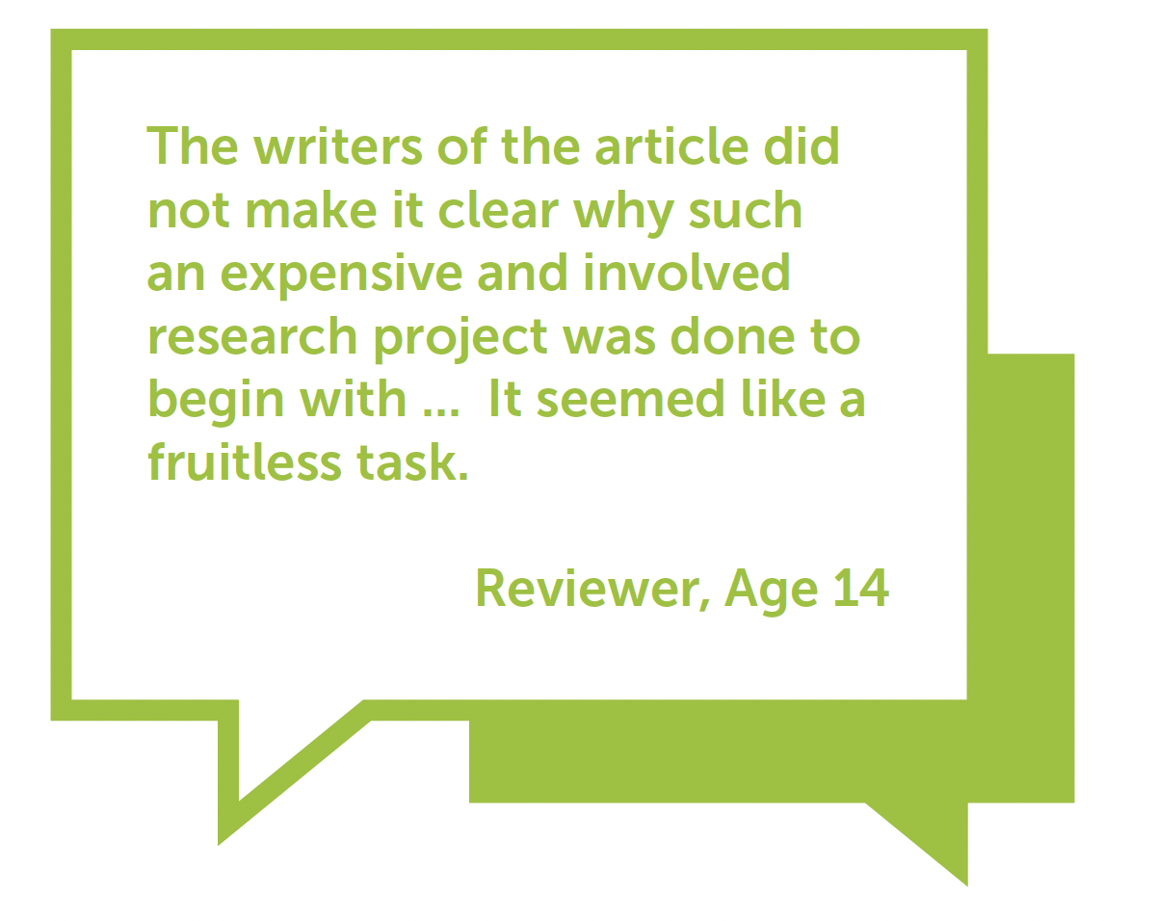
Genealogy-based inference of human evolutionary history
Luckily not our reviews…

Slide 22
Coalescence rates track relatedness through time
Coalescence rates = 1/M(t)
M(t): effective population size
Relatedness < 1000 years in East Asia
Relatedness through time globally

Slide 23
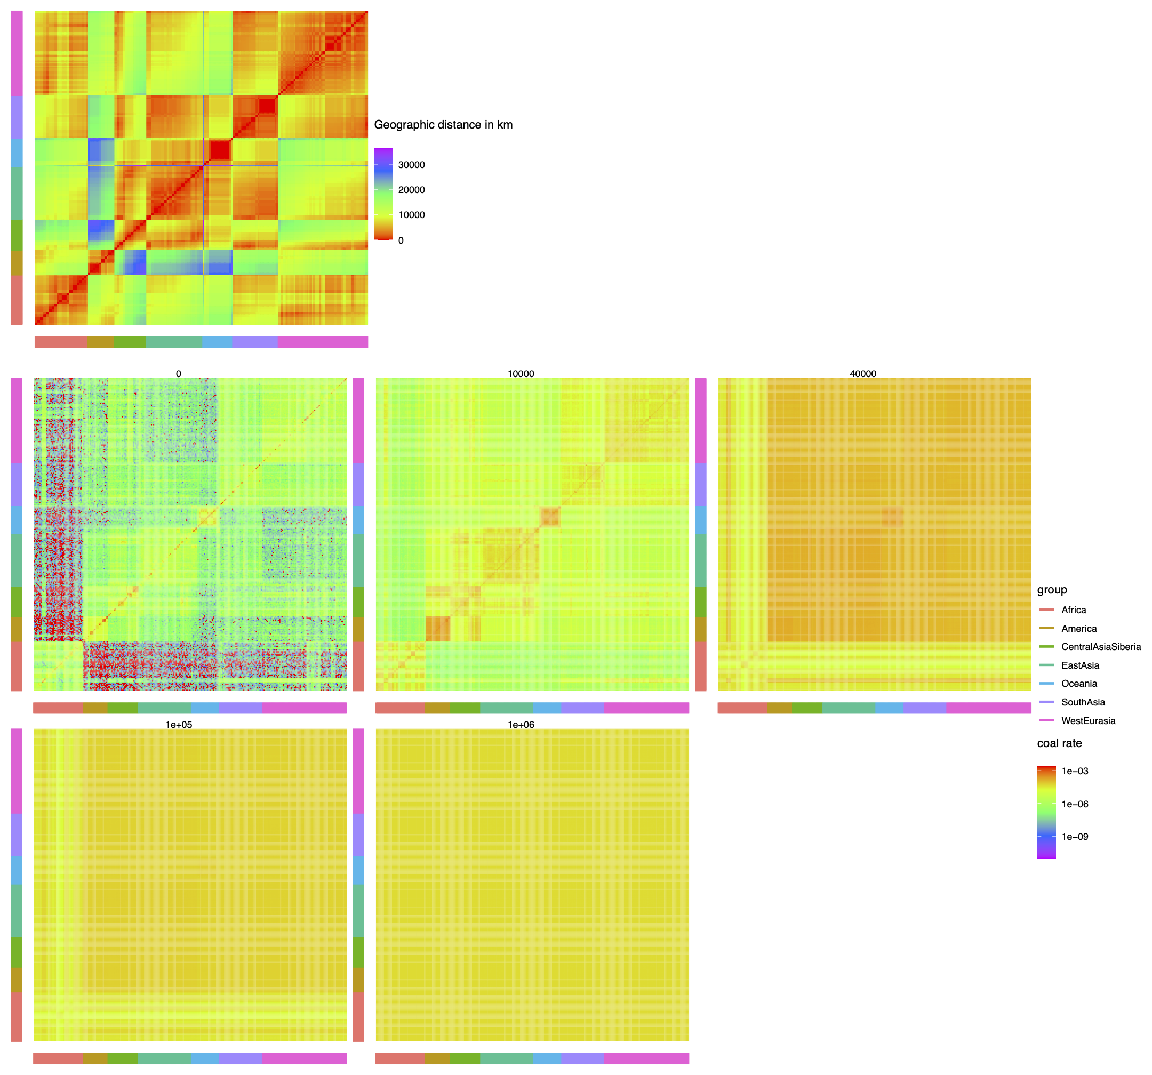
Structure through time
Geographic distance
0-1000
10,000
40,000
Coalescence rates
100,000
1,000,000
Coal rate = 1/M(t)

Slide 24
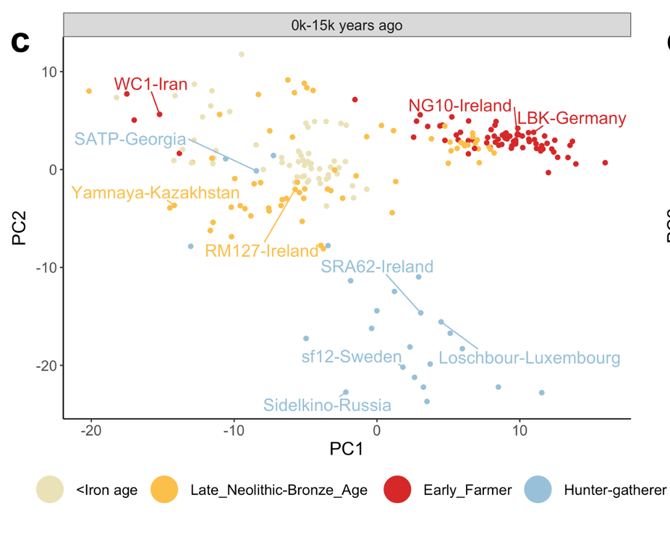
Repeated (almost) complete population replacements in Ireland within the space of 3000 years
PCA on matrix of coalescence rates
Yamnaya/Steppe
expansion
Western
Hunter gatherers
e.g., Yamnaya
Steppe Pastoralists
e.g., Loschbour
farming
Anatolia
e.g., Bon002

Slide 25
Clusters of mutations in time can capture changes in mutation rate
Mutation rate
time

Slide 26
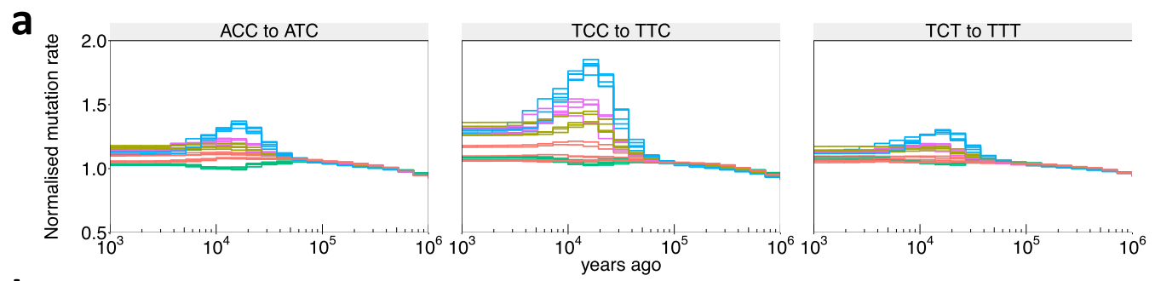
“Mysterious” TCC/TTC mutation rate in West Eurasia
First reported by Kelley Harris (PNAS 2015, eLife 2017)
Strongest signal of all triplets and strongest in Europeans among modern-day people
Unknown cause (genetic?, environmental?)
Date of onset unclear (dates range from 10k – 80k)
Studied mainly in moderns, handful of ancients (Mathieson & Reich 2018), but detailed geographic & temporal pattern was unexplored

Slide 27
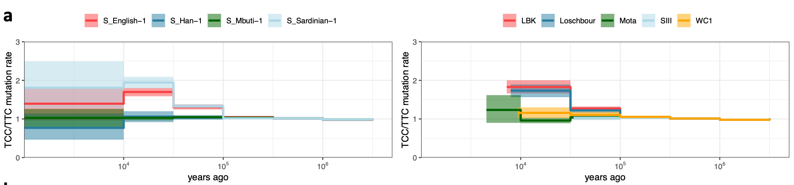
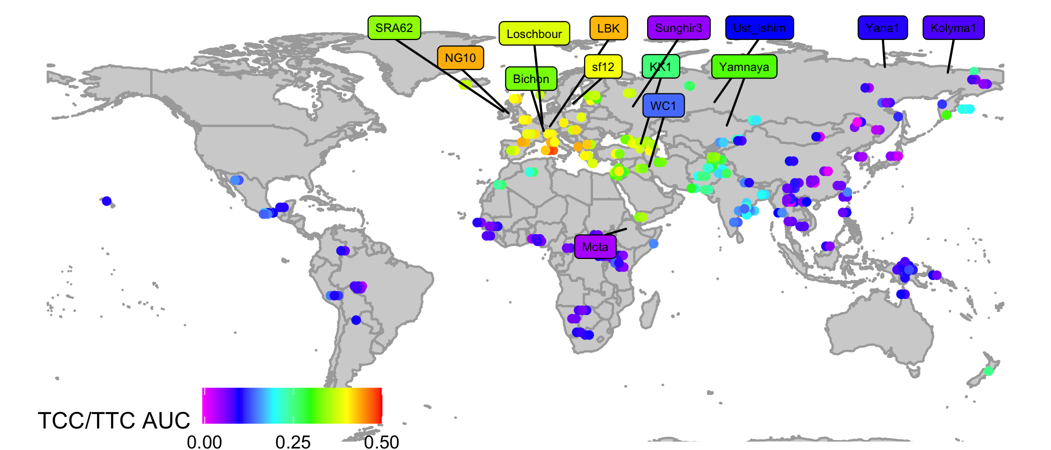
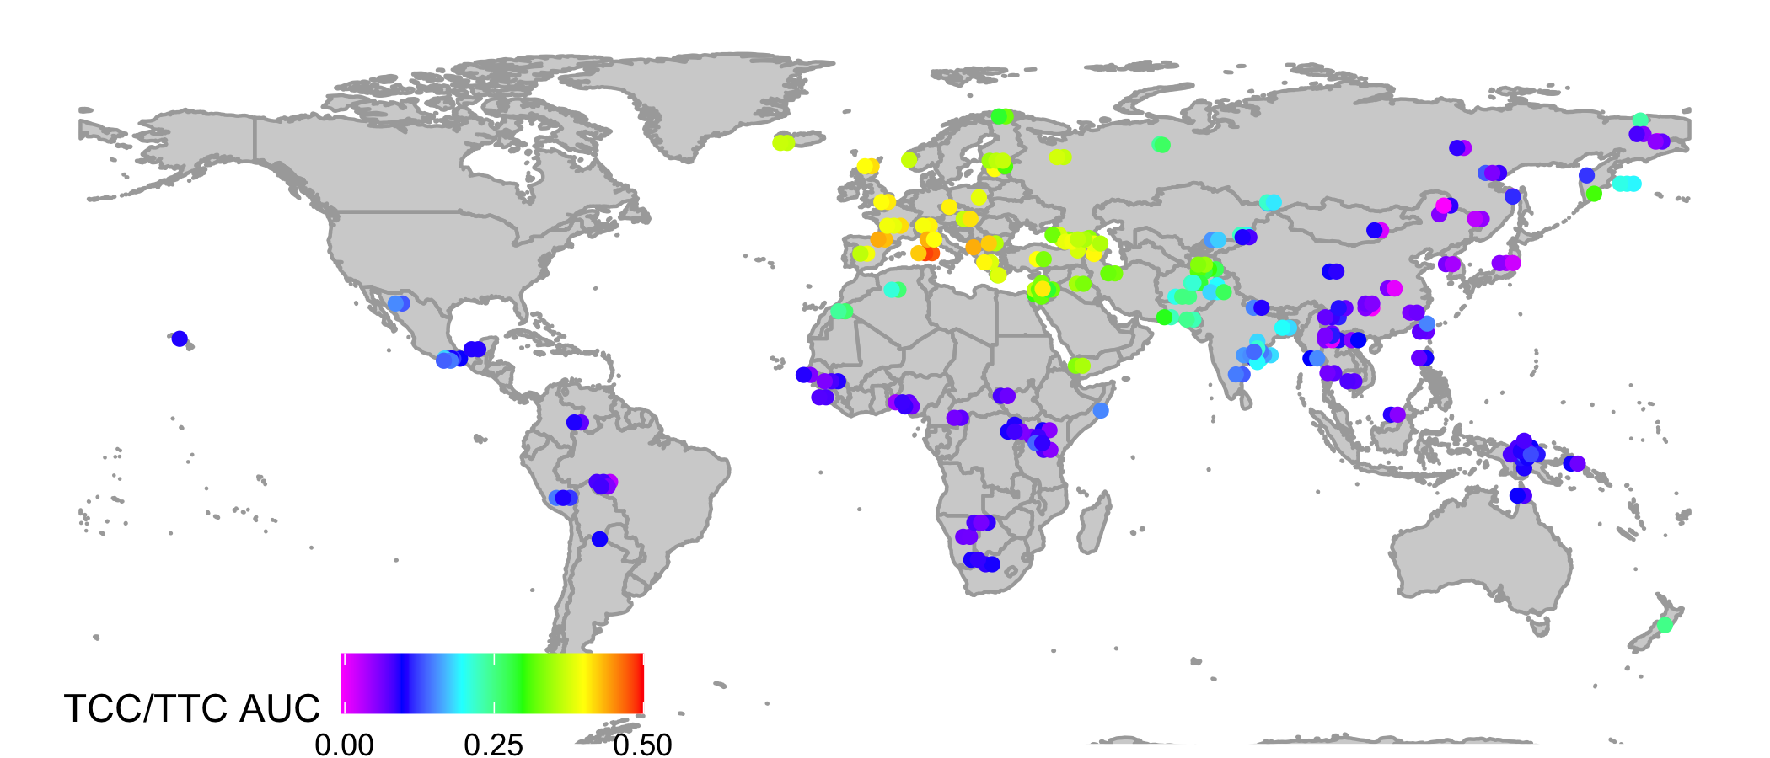
TCC/TTC mutation rate inferred from Relate genealogies
Speidel et al. bioRxiv, 2021
WHG
WHG
F
HG >30k
HG >30k
HG
HG
F
CHG
WHG
SHG
SP
F
F: farmer
WHG: Western HG
SHG: Scandinavian HG
CHG: Caucasus HG
SP: Steppe Pastoralist
HG
Circles: SGDP present-day individuals
Labels: high-cov ancients built into trees
Notes:
Add ancients

Slide 28
Quantifying positive natural selection on a single mutation
Genetic adaptations to changing environment, diet, lifestyles,…
Use trees incorporating demographic history
Reject a null model

Slide 29
How quickly does a mutation spread in the neutral case?
k = 2
Z₁=5
Z₂=2
n=7
We can write down the analytical distribution for the
number of descendants of a mutation arising while k lineages remain
Example: if k=2, this is just a uniform distribution
P(5 descendants)=1/6

Slide 30
The k = 2 case
We expect “unbalanced” tree shapes!
3
5
9
7
5
1
6
8
5
4
5
2
4
4
7
6
6
3

Slide 31
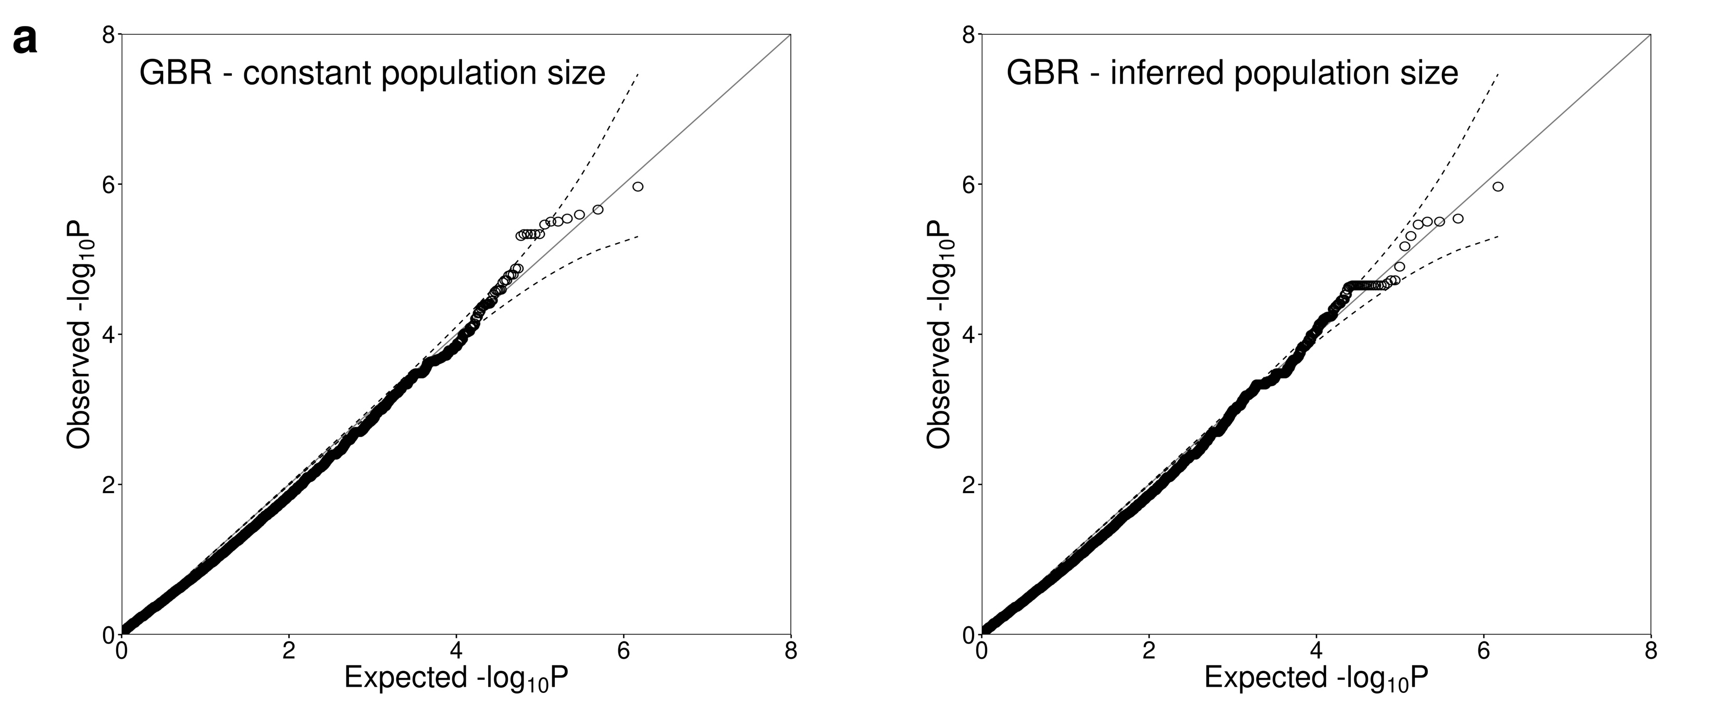
P-values: very well calibrated under null simulations of no selection
N=1000, 250Mb
Bottleneck population size
Quantile-quantile plot:
Incorrect constant population size
Inferred varying population size

Slide 32
Improved power to see weak selection

Slide 33
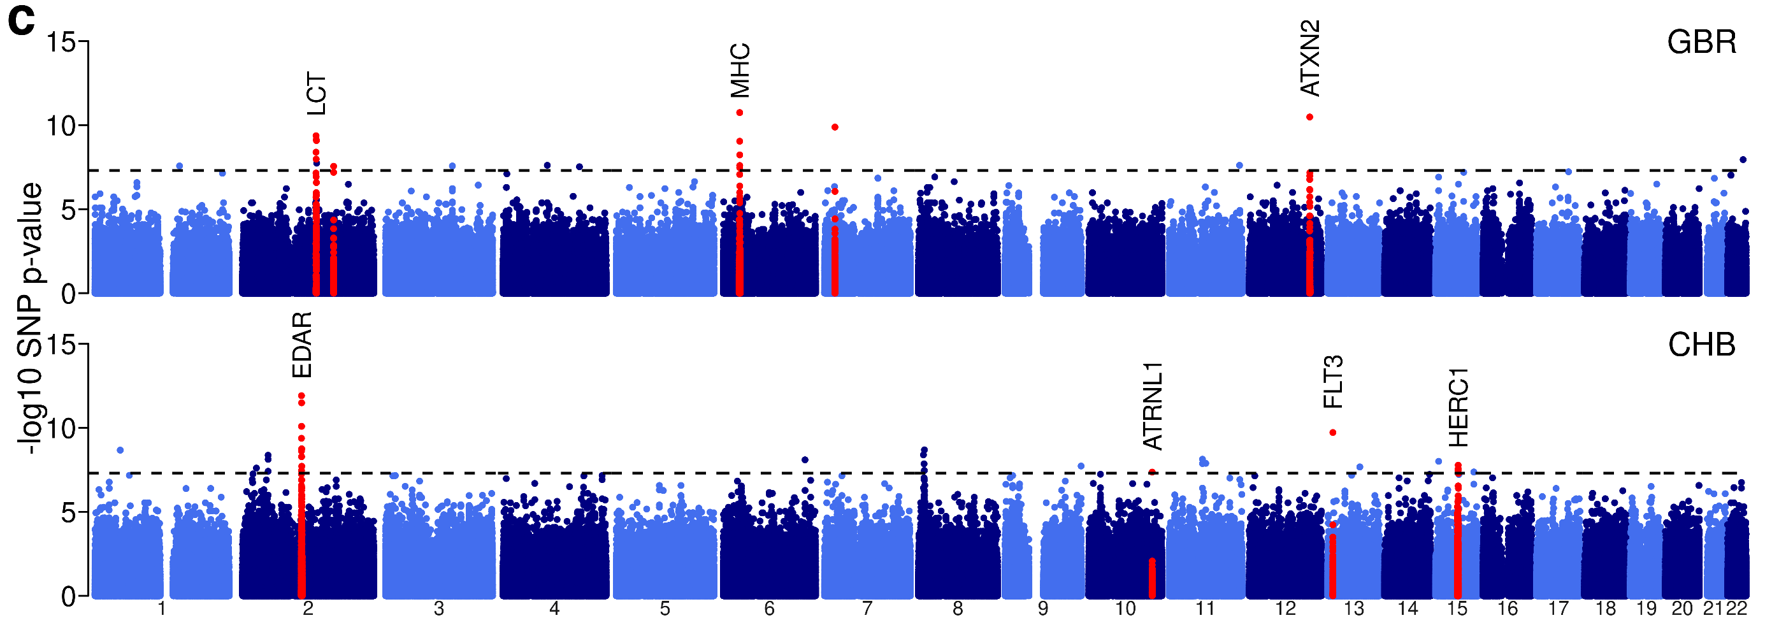
Genome-wide selection p-values
Given most traits are highly polygenic, expect mainly weak, polygenic selection
How does weak selection evidence vary by trait?

Slide 34
Many key events in our evolutionary history are only implicated as subtle effects in our genomes
Selection p-values: only a handful of “genome-wide significant” loci
log10 p-value
Lots of Polygenic selection signals
Weak selection on individual mutations
is hard to detect,
compared to shifts in distributions
Nominal significance
(p=0.05)
(no selection)
(weak selection)
(strong selection)

Slide 35
Evidence of selection on a trait: hair colour
Use effect direction of ”genome-wide significant” associations
Compare selection p-values to frequency matched random SNPs (Wilcoxon rank-sum test)
Relate p-values
iHS scores

Slide 36
Summary & future work
It is now possible to build genealogical trees for huge datasets, in humans and other species (currently 10,000 people or more)
These trees capture information about many processes including
Migrations and ancient introgression
Mutation rate evolution
Trait evolution
(and many more things)
Lots of scope for more methods using inferred genealogies:
Many existing approaches are based on idea of coalescent trees
These can often be adapted work directly with trees!
Deeper analysis of varying types of selection
Ghost ancestries, directional migration etc
Recombination evolution
Etc
….creative approaches to leverage trees to answer biological questions!

Slide 37




Thanks!
Simon Myers
Garrett Hellenthal
Pontus Skoglund
Aaron Stern
Lara Cassidy
Robbie Davies
Marie Forest
Sinan Shi
Sile Hu
Anubha Mahajan
Andrew Morris
Mark McCarthy
Daniel Falush
++

